Slide 1
API and Python training for network and systems engineers
Session 1

Slide 2
Session plan
Session 1
What is API
A bit of history
API examples
Types of API
REST API
How to consume API
Practice
Controllers
Next steps
Session 2
API authentication
Postman
Session 3
Python IDE
Python basics
Simple data types
Complex data types
Session 4
Python libraries, import statements
Requests module
Manipulating JSON
Session 5
Python procedures
Building Python application to consume API
Python classes
Session 6
What is SDK
Using SDK - examples
Session 7
Flask module
Building Python Flask application
Session 8
Connexion module
Adding API to your application

Slide 3
API and Python training
What we will be learning
We’ll learn how to use various tools to make queries to REST API endpoints.
We’ll be learning Python and specifically focus how to use it with REST API.
We won’t be focusing on network or systems automation specifically, but we’ll use Cisco SD-WAN and vCentre as examples
I’ll be preparing and share materials for each session, you’re more than welcome to suggest new topics
Some topics and definitions will be simplified, please find the time to find more details and read about what we discussed.
Similarly, we’ll be doing exercises, but it would be cool if you build and try your own examples.

Slide 4
Goals and tools
The goal of this training to get you comfortable with REST API – what is this, use cases, how to consume.
How to build Python applications not only to consume APIs, but also to build your own.
It is supposed you have little knowledge and no experience with programming concepts and Python
When you finish this training, you should be able to start building your own applications to use in your work or home projects whether it is SD-WAN, Raspberry PI, home automation - whenever your ideas brings you ☺
Explore , Experiment, ask questions ☺
Tools we will use
cURL
Postman
Python 3
IDE - integrated development environment (PyCharm)
Notes:
We’ll be using the tools such as Curl, Postman and IDE such as Pycharm.
IDE make the development process way easier.
If you have another IDE installed like VS Code, feel free to use it.

Slide 5
What we won’t cover
To stay focused, we won’t cover in detail:
Network automation tools, such as Ansible and StackStorm
Git
Data Models (such as YANG)
APIs and protocols other than REST API (such as NETCONF)

Slide 6
This session agenda
What is API
A bit of history
API use cases and examples
Types of API
REST API
How to consume API
Practice
Webhooks
Controllers
Next steps

Slide 7
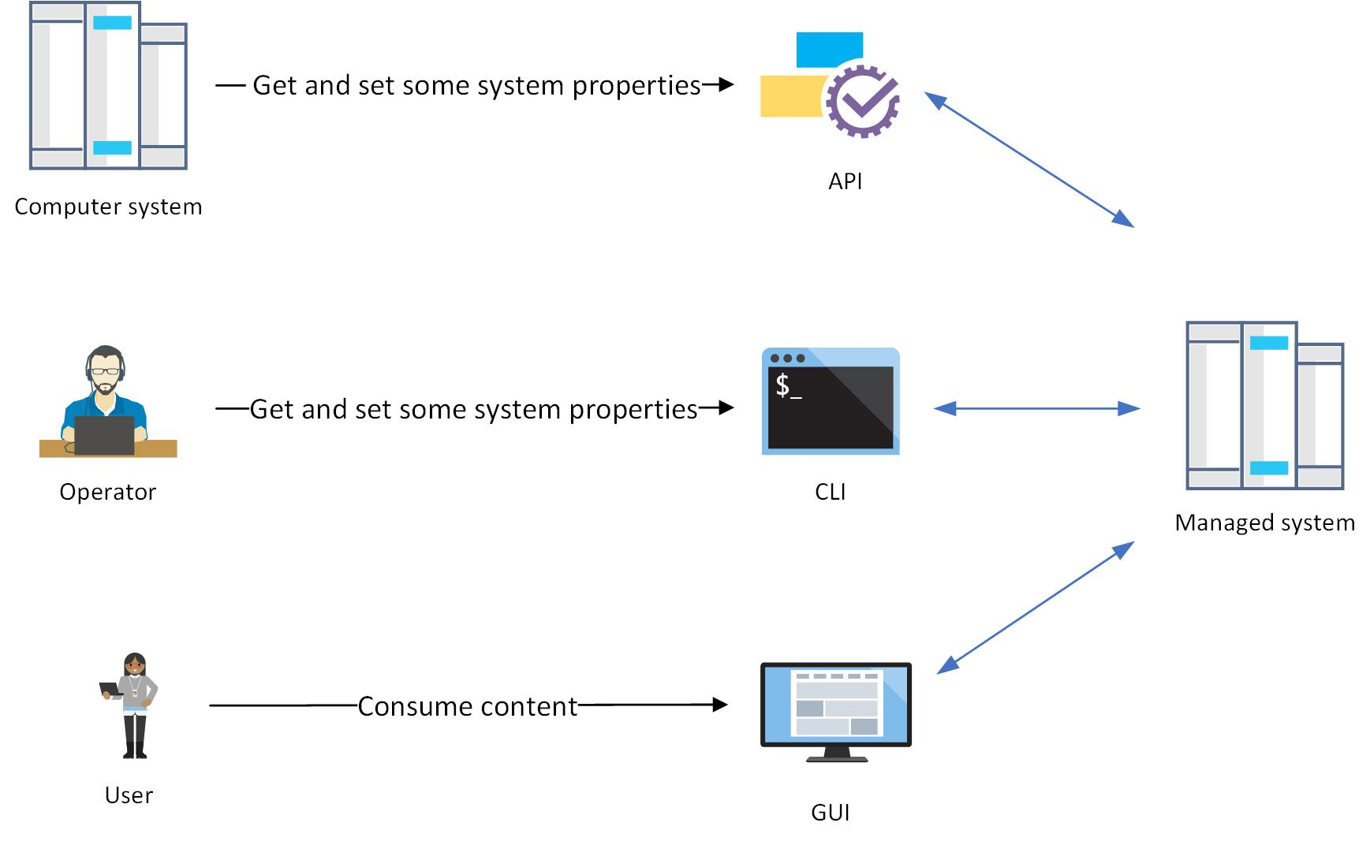
What is API
API – Application Programming Interface
Keyword here is still Interface
how we can interact with a system
Other types of interfaces:
CLI – Command Line Interface
GUI – Graphical Users Interface
They serve the same function, but differently
Notes:
An application programming interface (API) is a interface which defines interactions between multiple software systems. It defines the kinds of calls or requests that can be made, how to make them, the data formats that should be used, the conventions to follow, etc.
There are other types on interfaces, such as CLI, UI, but the keyword is really Interface – how to get the data from the managed system, or how to send the data or command. Behind the scene, this is the same application which implements the logic, so interfaces are really something it uses to communicate to the external world.

Slide 8
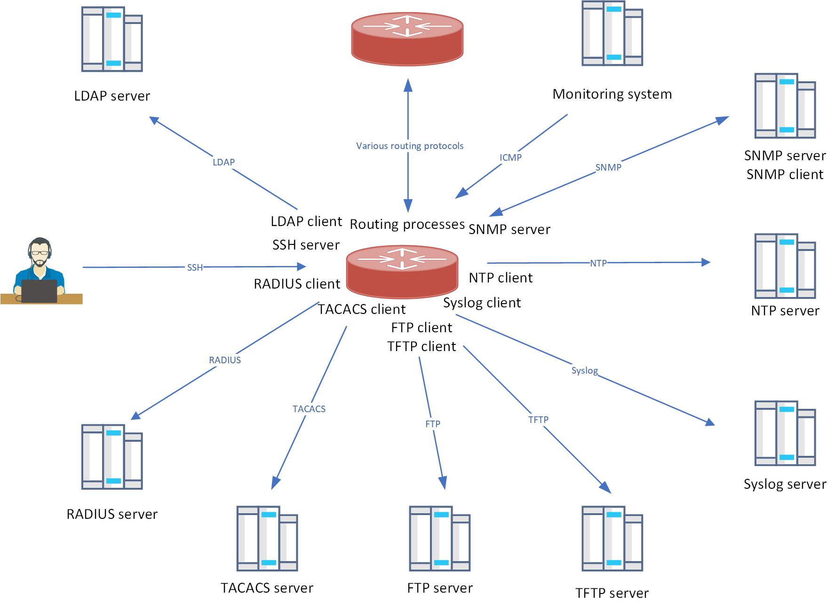
What protocols we use and what’s wrong with them
Different protocols for specific purposes
Problems:
All protocols work differently
Each protocol has its own packet formats
Each protocol requires its own client and server
To add functionality, invent a new protocol or add extensions, incompatible with previous (SNMP v2/v3)
The same protocol with added features of protocol can require using different ports (LDAP/LDAPS)
Difficult for operators to manage all this complex infrastructure and for developers to add new features or develop a new product
Security – multiple ports to open, difficult to track potential security issues with multiple software components

Slide 9
Software industry faced the same issue
Proprietary protocols, message formats, encoding rules
Monolith software, closed 3-tier architecture, very difficult to build distributed platforms
Difficult to make changes in software or implement new features
After quite a few transformations, the developer community and leading companies started adopting a new style of software architecture and building standard interfaces to their software components.
One if the most prominent works in this area is Roy Fielding’s dissertation Architectural Styles and the Design of Network-based Software Architectures:
https://twobithistory.org/2020/06/28/rest.html
https://www.ics.uci.edu/~fielding/pubs/dissertation/fielding_dissertation.pdf

Slide 10


All teams will henceforth expose their data and functionality through service interfaces.
Teams must communicate with each other through these interfaces.
……
All service interfaces, without exception, must be designed from the ground up to be externalizable.
Anyone who doesn’t do this will be fired.
Have a nice day
https://gigaom.com/2011/10/12/419-the-biggest-thing-amazon-got-right-the-platform/
Notes:
Some companies also started adopting a new approach, to build such scalable software architectures and one of them was AWS.
There is a famous email apparently sent by Jeff Bezos to AWS development teams.
So these companies started deploying these service interface between software components and making them as standard as possible
As a result, they had to choose one standard protocol as to build these standard interfaces.

Slide 11

One protocol to rule them all

Slide 12
Web API
Single transport – HTTP
Single port – 443 (or 80)
Simple model - Request/reply
Encryption from the box - HTTPS
Text-based, lightweight
Easy to implement, easy to consume
The same approach is used for inter-systems data exchange or within the same application (microservices)
Booking and eCommerce sites, payment gateways, public clouds, social media – all of them use Web APIs
You can get data from these systems and implement a business logic or workflow
Google : API economy

Slide 13

Examples
Get current weather:
http://www.bom.gov.au/fwo/IDV60901/IDV60901.95936.json
Close the blinds:
https://github.com/drbrain/indigo-powerview

Slide 14
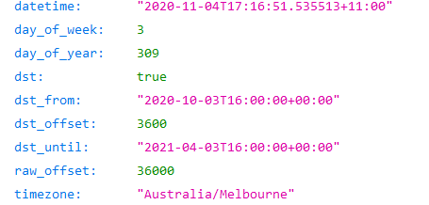

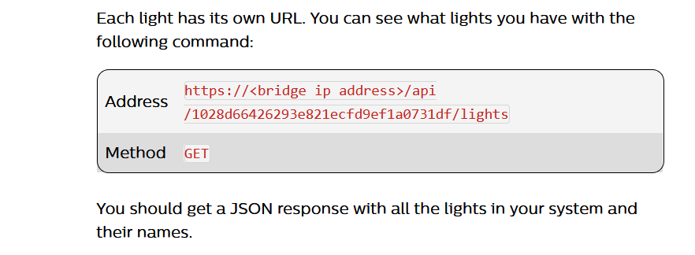
Examples
Get current time:
http://worldtimeapi.org/api/ip
Turn on the lights:
https://developers.meethue.com/develop/get-started-2/#turning-a-light-on-and-off

Slide 15


Examples
Your favourite stock has just dropped 10% ?
https://asxonline.com/public/documents/market-information-application--mia----rest-programmatic-interfa.html
Post another kitten in Facebook:
https://developers.facebook.com/docs/graph-api/resumable-upload-api

Slide 16

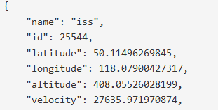
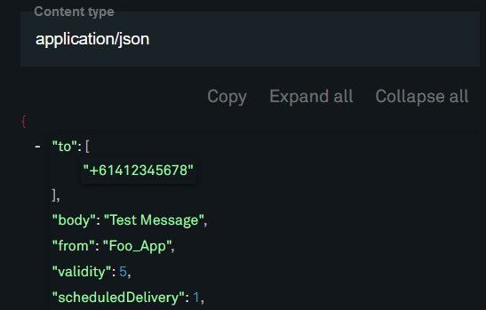
Examples
ISS is flying above your home?
https://wheretheiss.at/w/developer
Send a text:
https://dev.telstra.com/content/messaging-api

Slide 17
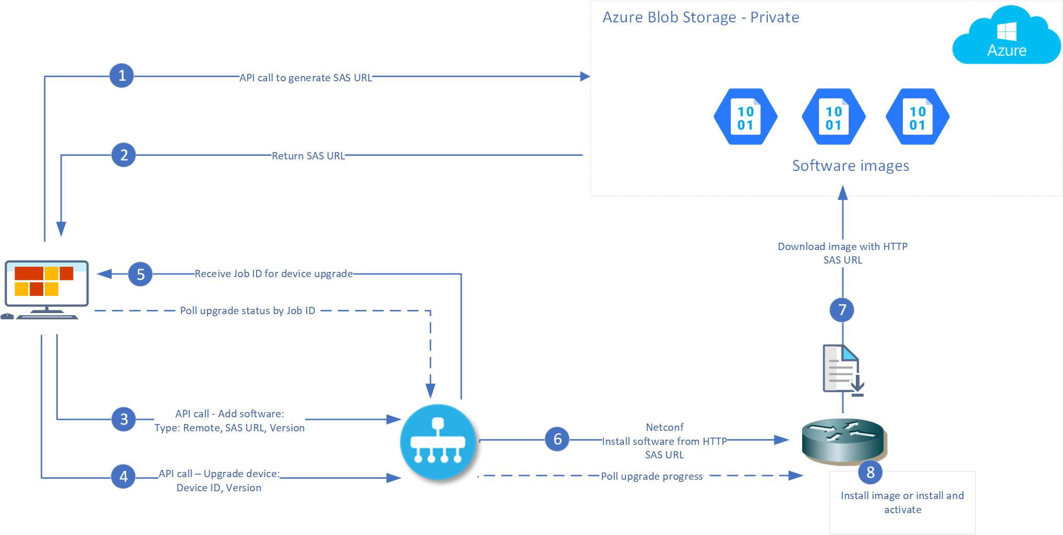
How we use API
ServiceNow retrieve Alerts from vManage API and raises tickets
StackStorm uses vManage API
LogicMonitor retrieves cellular signal monitor from vManage
Ansible modules to communicate with Storage
Automatic routers upgrade
make API call to Azure to generate unique URL
make API call to vManage
instructing it to start upgrade process of routers

Slide 18
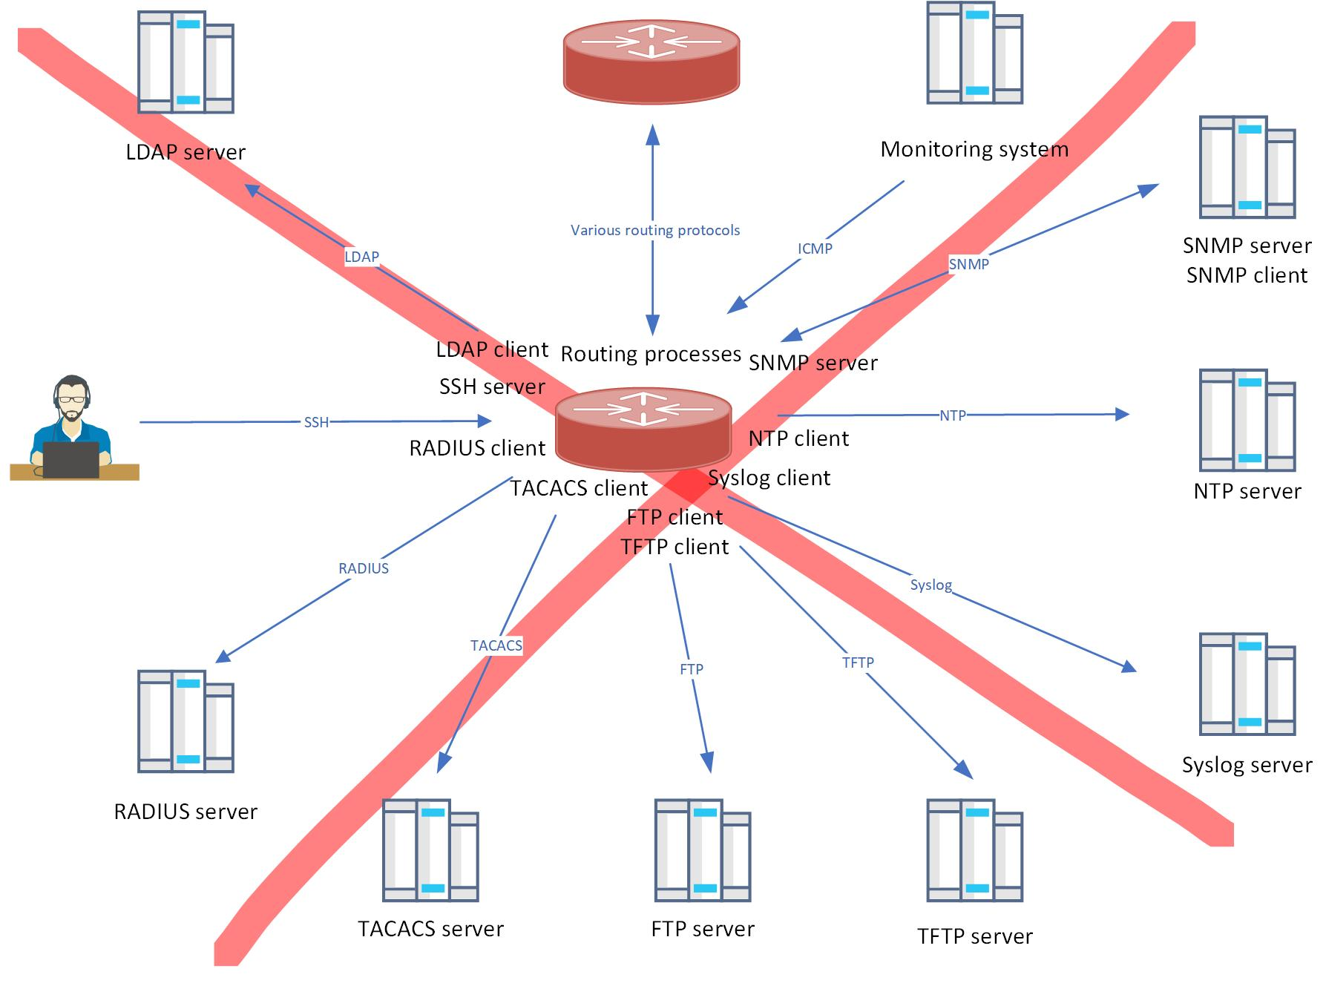
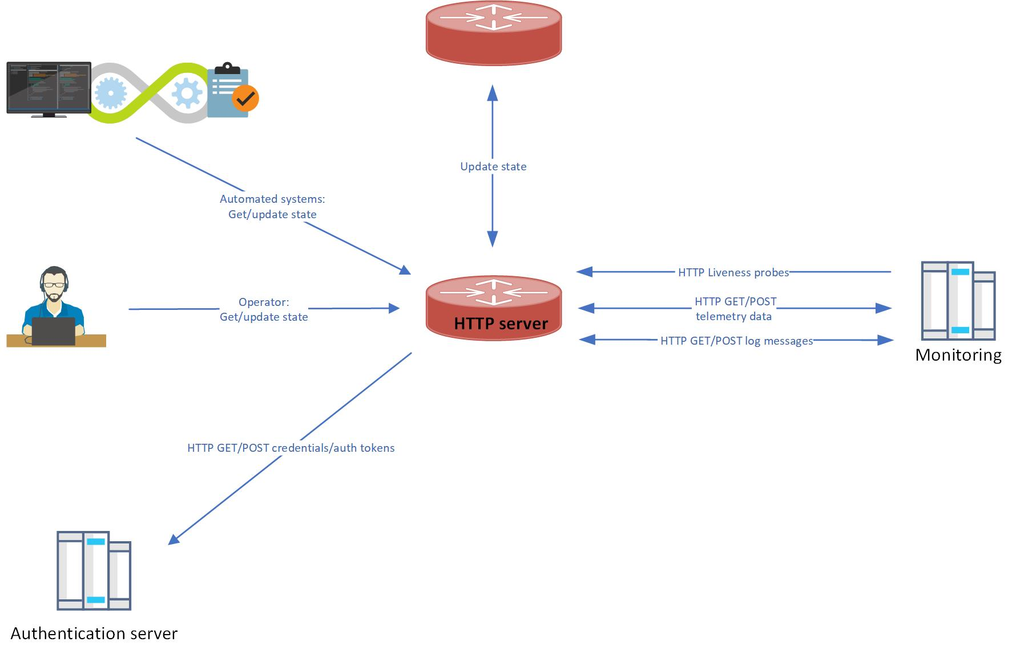
API is getting more and more common in modern networks

Slide 19
Different APIs
As mentioned before, API is a broad term, but we’ll use Web API which is the most common meaning of the term API
There two main types of Web APIs:
SOAP
still used, but not very common these days. W3C Standard, transport-independent, uses XML
REST
the key part of most modern web applications, most commonly used, leverages HTTP transport and JSON as data format
https://www.upwork.com/resources/soap-vs-rest-a-look-at-two-different-api-styles
We’ll focus of REST API.
Notes:
We’ll only consider REST API
When used in this way, the term API has some overlap in meaning with the terms communication protocol and remote procedure call.
https://en.wikipedia.org/wiki/API
Good reference : https://www.upwork.com/resources/soap-vs-rest-a-look-at-two-different-api-styles

Slide 20
What is REST API
REST is actually not a protocol, but software architecture style and Web service APIs that adhere to the REST architectural constraints are called RESTful APIs
It’s worth mentioning some of these constraints here, please make sure to check all six of them: https://en.wikipedia.org/wiki/Representational_state_transfer
Uniform Interface:
Resource identification in requests, for example, https://vmanage/device or https://vmanage/policy/policy-id - here device and policy-id are called resources
Manipulation of Resources Using Representations - client can request data in JSON or XML format, you can see this later in Headers: Accept: application/json
This data (text) we receive doesn’t reflect server’s internal data or logic; they are independent.
Notes:
In this training for simplicity we’ll use REST API and just API as synonyms. Just be aware the definitions of API and REST are not the same.
Strictly speaking, REST API is not protocol, a list of constraints.

Slide 21

REST API – Client-Server
Client-Server: REST application should have a client-server architecture.
Client doesn’t need to know anything about business logic and server doesn’t need to know anything about client, as long as a request is in correct format.
A client can be anything – mobile app, IoT device, web page, router, etc….
An example of system interaction not using client-server architecture – routing protocols or peer-to-peer networks
Notes:
Only two types of messages – Request and Response, nothing else.

Slide 22

REST API - Stateless
Statelessness
Each request from any client contains all the information necessary to service the request, and the session state is held in the client.
Compare to CLI:
So the command you are executing depends on the context you’re in, and the server tracks the current context
In REST API the client is responsible to provide all the necessary information, so the server can fulfill the request. This includes URI, headers, authentication credentials and any parameters.
Each request is processed independently from any other
As a result there is no concept such as ‘commit’ – the request is processed immediately

Slide 23
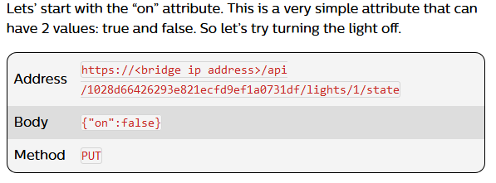
REST API messages
Four most commonly used messages (also called as verbs):
GET – get list of resources, or details about particular resource. Remember resources are specified in a request URI, for example:
GET https://router/configuration/acls - get router’s access-list
GET https://router/configuration/acls/id-123456 - get details about a particular access-list
Note there can’t be request methods like GET-ROUTER-ACCESS-LIST
POST - create a resource, for example, create a new access-list
PUT - update a resource
DELETE – deletes resource
Less commonly used, we won’t consider them:
PATCH, HEAD, OPTIONS
https://en.wikipedia.org/wiki/Hypertext_Transfer_Protocol#Request_methods
Notes:
Request messages also often called verbs and really there are 4 most commonly used messages
The first one is GET which is used for getting some data, we’ll use this one in probably 90% of cases.
Next is POST – do some operation, create a resource, the second most use command
PUT is to update a resource and finally DELETE

Slide 24
Request URL
https://api.exchangeratesapi.io/latest?base=AUD&symbols=USD
^^^^^^^^^^^^^^^ ^^^ ^ ^^^^^^^^^^^^^^^^
Host Resource Parameters
Host + Resource is API endpoint
Always contain Headers, most common:
Authorization – username/password, key, bearer, etc, we’ll cover it later
Content-Type - data format of the request body, for example application/json
Accept – data format requested from the server, for example application/json
Optionally can have Payload (body) – can be json, binary (for file upload), etc

Slide 25
Response
Always contains response code and status message, for example:
Code Message Meaning
200 OK Success - 2xx responses - Success
401 Unauthorized Authentication missing or incorrect - 4xx responses – Client error
404 Not Found Resource not found/wrong URL
500 Internal Server Error - 5xx responses – Server error
Service Unavailable Server is unable to complete request
See:
https://en.wikipedia.org/wiki/List_of_HTTP_status_codes

Slide 26
Response
Always contain Headers
Always contain Body – this is what we want to receive from the server (if request completed)
Most common is JSON:
{
"base": "AUD",
"date": "2020-11-04",
"rates": {
"USD": 0.7170561605
}
}
Client’s (requester’s) can then parse this data and do something with them
Notes:
Similar to Request, response also contains Headers, and if the request is successful and we get 200 OK response and receive some data in body.
This is text – usually JSON format.
So once the client receives this data, it should get some useful info, and this what we are go to with Python in this training course.

Slide 27
REST API message formats - GET
Request Verb -------->
Headers ------------------>
Response Status ----------->
Headers ----------------->
Response Body (Payload)
> GET http://worldtimeapi.org/api/ip HTTP/1.1
> User-Agent: curl/7.29.0
> Host: worldtimeapi.org
> Accept: */*
> Proxy-Connection: Keep-Alive
>
< HTTP/1.1 200 OK <<<< Status code and text
< Access-Control-Allow-Credentials: true
< Access-Control-Allow-Origin: *
< Access-Control-Expose-Headers:
< Cache-Control: max-age=0, private, must-revalidate
< Content-Length: 399
< Content-Type: application/json; charset=utf-8
< Cross-Origin-Window-Policy: deny
< Date: Wed, 04 Nov 2020 23:31:47 GMT
< X-Request-Id: b89182b8-a667-4c67-90a5-54f0aacace5c
{"abbreviation":"AEDT","client_ip":"118.127.80.40","datetime":"2020-11-05T10:31:48.549066+11:00","day_of_week":4,"day_of_year":310,"dst":true,"dst_from":"2020-10-03T16:00:00+00:00","dst_offset":3600,"dst_until":"2021-04-03T16:00:00+00:00","raw_offset":36000,"timezone":"Australia/Sydney","unixtime":1604532708,"utc_datetime":"2020-11-04T23:31:48.549066+00:00","utc_offset":"+11:00","week_number":45}

Slide 28
How to consume API
What you need to know:
API documentation - Normally API contains documentation and examples, so the first step is to read the doc to see auth and methods are supported, what format is expected, etc
https://wheretheiss.at/w/developer http://worldtimeapi.org/ https://ipwhois.io/documentation
https://developers.facebook.com/docs/graph-api/overview/ https://<vManage>/apidocs
Know API endpoint which consists of:
Server URL - API server – just a Web server, lightweight, as there no GUI, for example, NGNIX or Flask. In prod is usually behind a load-balancer
Resource - path like /device/interface/id or /client/payments/
Client
Your browser
CURL
Postman
Programming language

Slide 29
Practice time! – Basic GET requests with cURL
Raw ouput:
curl -v "http://worldtimeapi.org/api/ip"
curl -v "http://worldtimeapi.org/api/ip"
Pretty output:
curl -v "http://worldtimeapi.org/api/ip" | python -m json.tool
No parameters:
curl -v https://ipwhois.app/json/8.8.8.8| python -m json.tool
Let’s include parameters:
curl -v https://ipwhois.app/json/8.8.8.8?objects=country,city,timezone | python -m json.tool
Single parameter:
curl https://api.exchangeratesapi.io/latest?base=AUD | python -m json.tool
Multiple parameters: NOTE – here URI is in ‘’ as & is a command in Linux
curl 'https://api.exchangeratesapi.io/latest?base=AUD&symbols=USD' | python -m json.tool
More complex response: curl "https://endpoints.office.com/endpoints/worldwide?clientrequestid=b10c5ed1-bad1-445f-b386-b919946339a7" -x 172.21.40.146:8080
Body in the request: curl -H 'Content-Type: application/json' -d '{"text": "Test message via Webhook"}' https://outlook.office.com/webhook/82e433c98-a978-465f-8254-9d541ee73c/IncomingWebhook/cb6d6416f49aaba3bd52357266
Notes:
Today we use services which don’t require registration or API keys, next time we’ll do requests with authentication
http://worldtimeapi.org/
https://ipwhois.io/
https://api.exchangeratesapi.io/
cURL CLI keys: see https://ec.haxx.se/cmdline/cmdline-options for full list or use curl --help
-x - use Proxy
-k or --insecure – ignore certificate warnings
-v – verbose
-X or –request - specify requests, GET by default
-d - data (body)

Slide 30
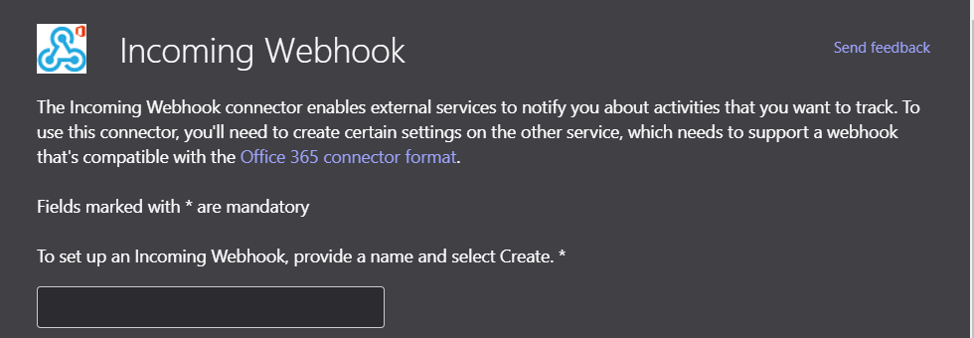
Webhooks
Last command we done is made to MS Teams webook
Webhook = API endpoint
Used to communicate to the application in the real-time
In most cases works like a trigger for the app to do some actions
Usually consumed with POST commands
In our case this is webhook to MS Teams
app which posts messages to the channel
The same approach for Webex or Slack
https://developer.webex.com/docs/api/guides/webhooks
https://docs.microsoft.com/en-us/microsoftteams/platform/webhooks-and-connectors/how-to/connectors-using#example-connector-message
https://docs.github.com/en/free-pro-team@latest/developers/webhooks-and-events/about-webhooks

Slide 31
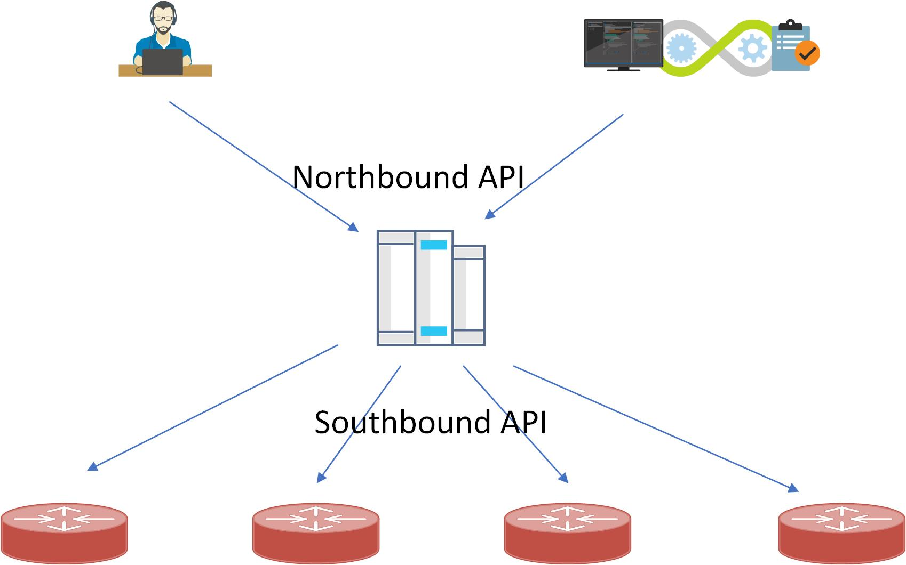
Controllers
It’s possible to make API calls individually to each router, node, or lighting bulb.
However, this is not scalable, not very secure architecture, so the most common method is to use a controller.
Controllers offers consumable API, doing authentication, RBAC, etc. This type of API exposed to be used is called northbound API.
Controllers maintain connections to identify the operational state of controlled devices, push configuration, pull logs. Controlled devices also can push alerts, state changes. This type of comms is called southbound API. This API can be proprietary, maybe even SSH or SNMP.
Example of controllers:
Cisco vManage NSX Manager Kubernetes Master
Philips Hue Lighting Google Smart Home
Public clouds also provide API endpoints to control resources, so they can be also considered as controllers to some extent.
These APIs and the controller what makes Software Defined in any SDN including SD-WAN

Slide 32
Summary and home work
Today was an introduction session and we learned:
What is API
What is REST API
Request and responses
How to use cURL
Homework: ☺
Read more about REST API
Think of use cases
Ask questions, I’m happy to answer them
Get familiar with Meraki API - Explore resources, requests and responses
https://documentation.meraki.com/General_Administration/Other_Topics/The_Cisco_Meraki_Dashboard_API

Slide 33
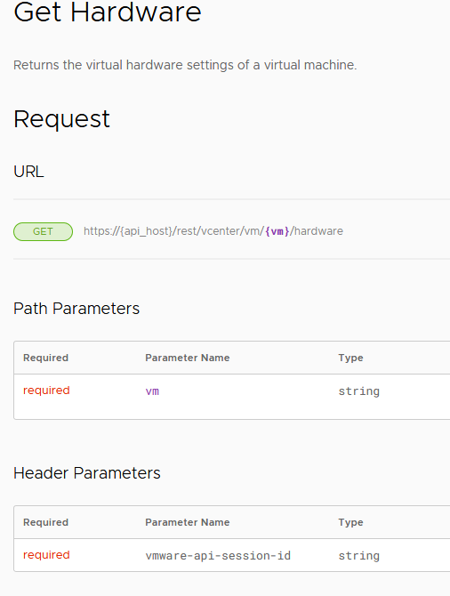
vCentre API
Have a look at the REST API documentation
https://developer.vmware.com/docs/vsphere-automation/latest/vcenter/rest/vcenter/vm/vm/hardware/get/
This is a typical API documentation
Notice how the documentation looks like, example of
Requests, Responses, Parameters, Headers, Errors

Slide 34
What we’ll do next time
Explore and try different types of authentication
Practice with Postman using free public API and vManage
After that we’ll focus on Python

